Slide 1
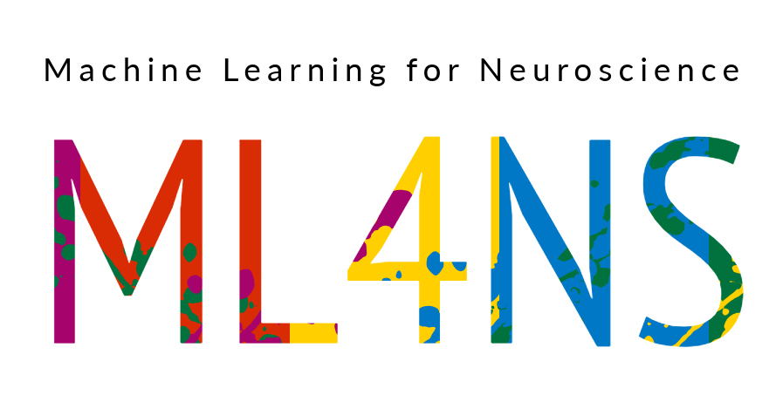
Convolutional Neural Networks (CNNs)
Payam Barnaghi
Department of Brain Sciences &
School of Convergence Science in Human and Artificial Intelligence
Imperial College London
January 2025
Notes:
1

Slide 2
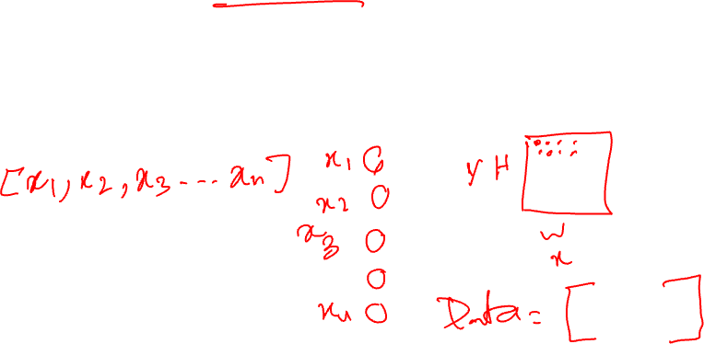
Feature Vectors
Image data is represented as a two-dimensional grid of pixels, monochromatic or colour.
Each pixel corresponds to one or multiple numerical values, respectively.
Until now, most of the models that we have studied have ignored this rich structure and treated the data as vectors of numbers.

Slide 3
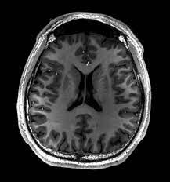
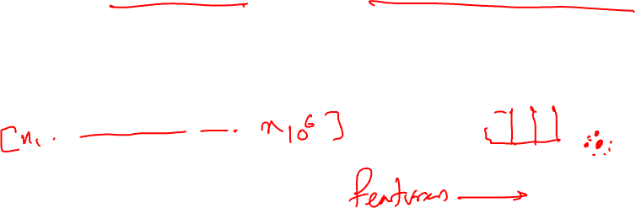
Images a vectors
Using images by flattening the images means overlooking the spatial relation between pixels.
This deeply unsatisfying approach could be a very simple solution to feed the resulting one-dimensional vectors through a fully connected MLP or other probabilistic models.

Slide 4
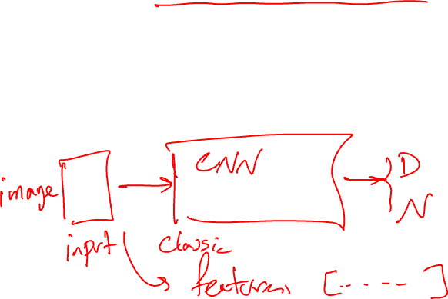
Feeding images to the models as blocks
Because the MLP networks are invariant to the order of the features, we could get similar results regardless of whether we preserve an order corresponding to the spatial structure of the pixels or if we permute the columns of our design matrix before fitting the MLP’s parameters.
Preferably, we would leverage our prior knowledge that nearby pixels are typically related to each other to build efficient models for learning from image data.

Slide 5
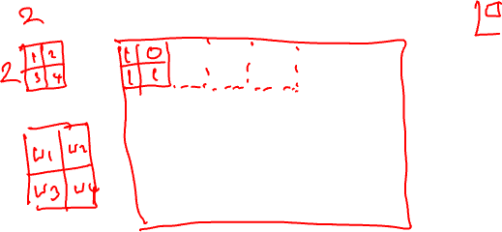
Convolutional Neural Networks
Convolutional Neural Networks, or CNNs, are specialised neural networks that process data with a known grid-like topology.
Examples include time series data, which can be thought of as a 1-D grid taking samples at regular intervals, and image data, which can be thought of as a 2-D grid of pixels.

Slide 6
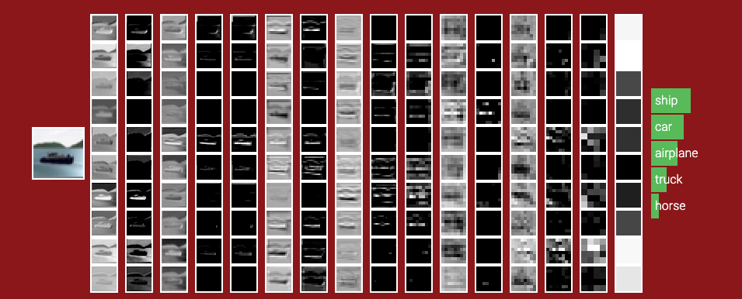
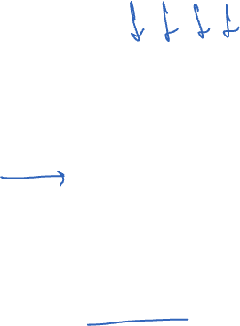
CNNs
image source: http://cs231n.stanford.edu/
We will revisit this again in the following slides.

Slide 7
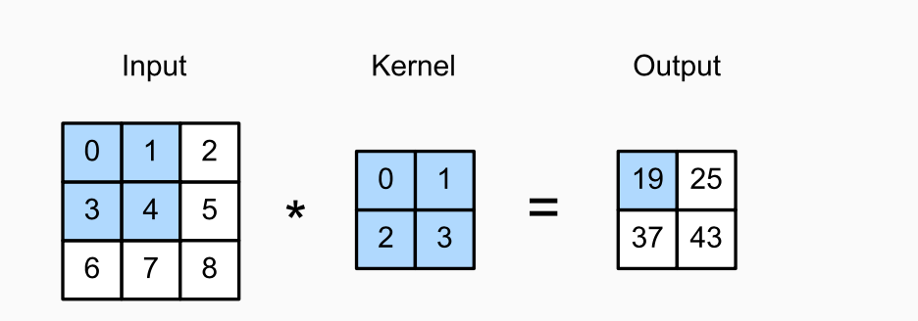
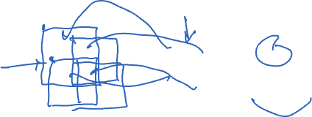
Convolution layer
Convolutional layers in CNN can be more accurately described as cross-correlations.
They take an input (usually a grid or subset of the main image or input) and overlay or apply a kernel.
The shape of the kernel window (or convolution window) is given by the height and width of the kernel.
Source: Dive into Deep Learning, Aston Zhang et al., https://d2l.ai

Slide 8
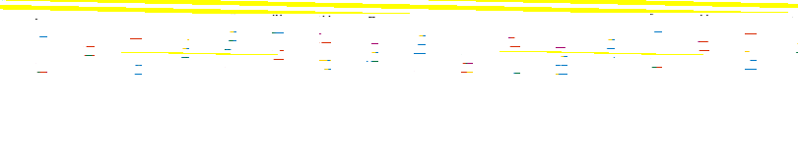
CNN kernels
$$\left(1×0\right)+\left(2×1\right)+\left(4×2\right)+\left(5×3\right)=25$$
$$\left(4×0\right)+\left(5×1\right)+\left(7×2\right)+\left(8×3\right)=43$$
$$\left(3×0\right)+\left(4×1\right)+\left(6×2\right)+\left(7×3\right)=37$$
Two-dimensional cross-correlation operation. The shaded portions are the first output element, as well as the input and kernel tensor elements used for the output computation:
(0×0) + (1×1)+ (3×2)+ (4×3)=19.
Source: Dive into Deep Learning, Aston Zhang et al., https://d2l.ai

Slide 9
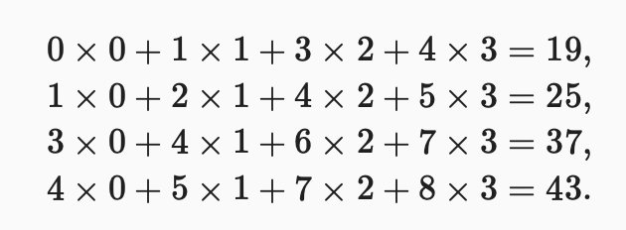

Sliding the kernel
Source: Dive into Deep Learning, Aston Zhang et al., https://d2l.ai

Slide 10
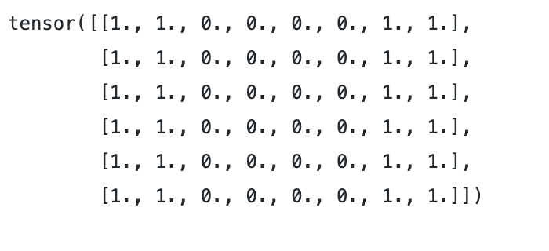
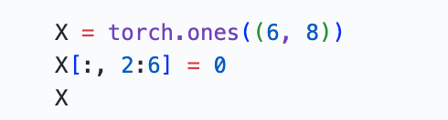

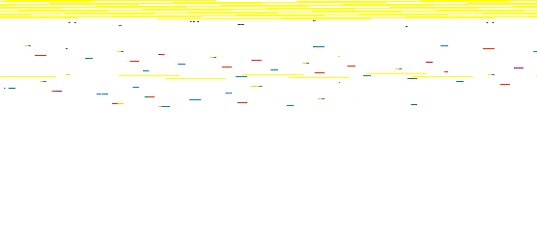
Example – edge detection: data
Code: GitHub - CNN_edge_detection_sample.ipynb

Slide 11
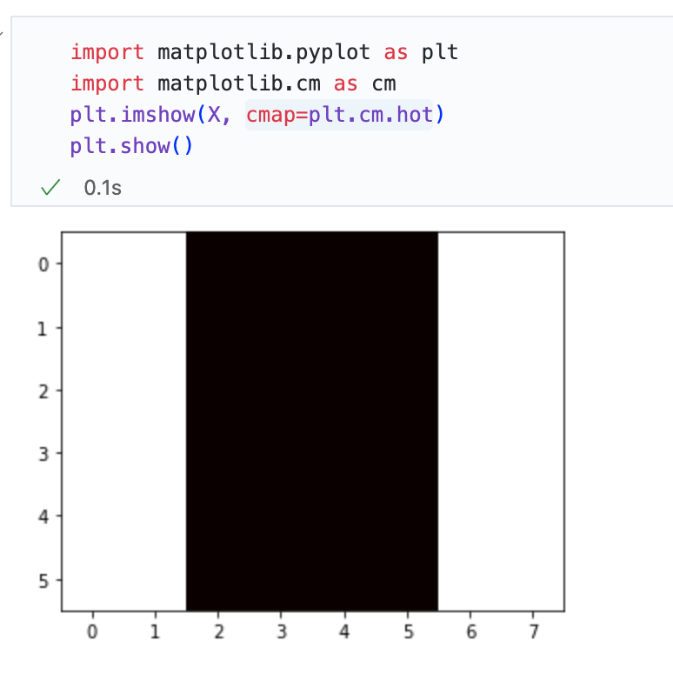

Example – edge detection: data

Slide 12
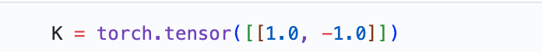
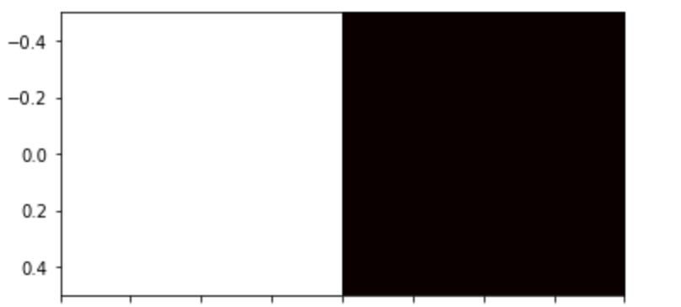
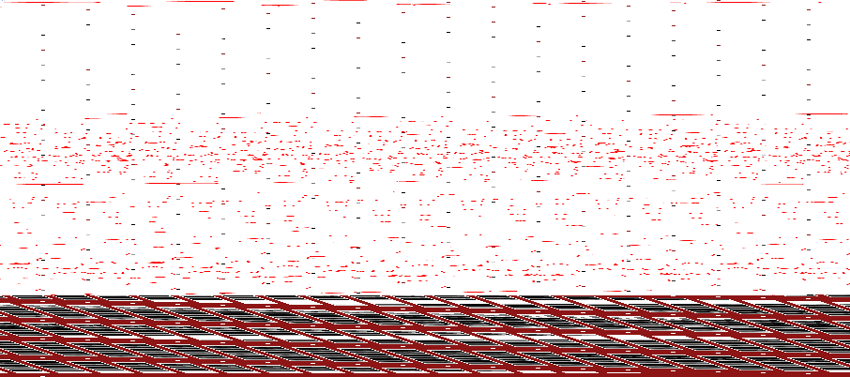
Example – edge detection: kernel
Code: GitHub - CNN_edge_detection_sample.ipynb

Slide 13
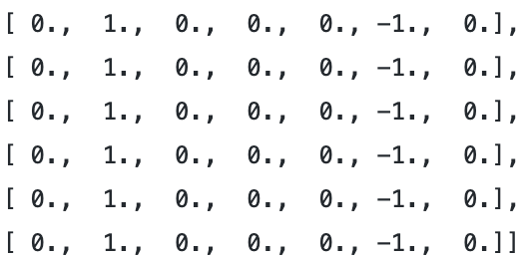
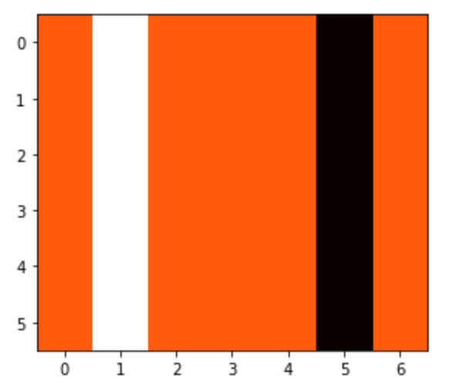
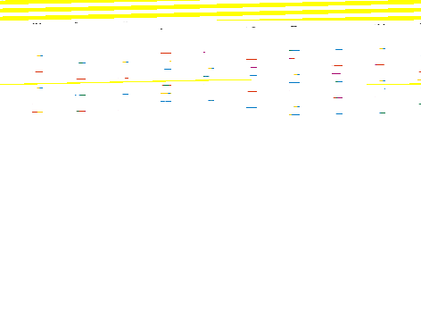
Example – edge detection: result
Code: GitHub - CNN_edge_detection_sample.ipynb

Slide 14
Learning a kernel
Designing an edge detector by finite differences [1,-1] is neat if we know this is precisely what we are looking for.
However, as we look at larger kernels and consider successive layers of convolutions, it might be impossible to specify precisely what each filter should be doing manually.

Slide 15
Learning a kernel through training
We can learn the kernel that generated Y from X by looking only at the input-output pairs. We first construct a convolutional layer and initialise its kernel as a random tensor.
Next, in each iteration, we will use the squared error to compare Y with the convolutional layer output.
We can then calculate the gradient to update the kernel.

Slide 16
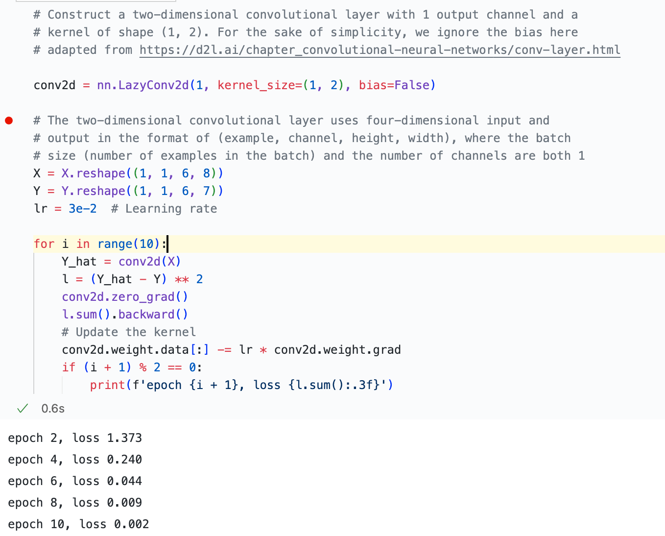

Example: how to learn a kernel
Code: GitHub - CNN_edge_detection_sample.ipynb

Slide 17
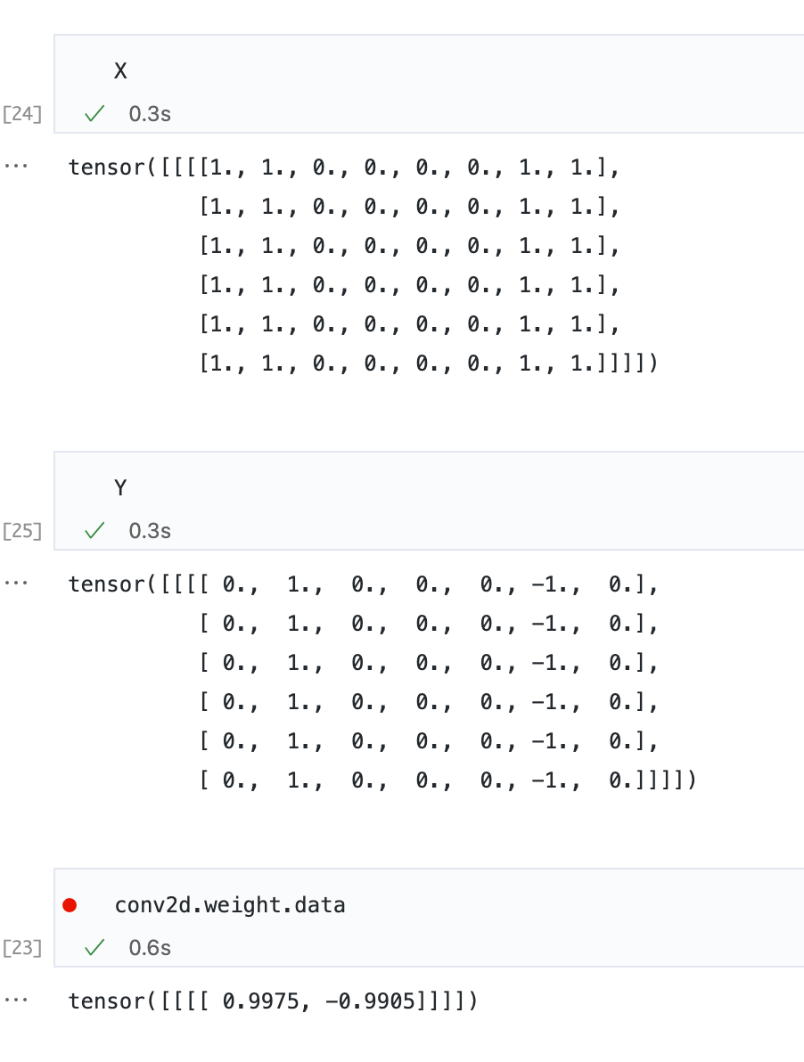
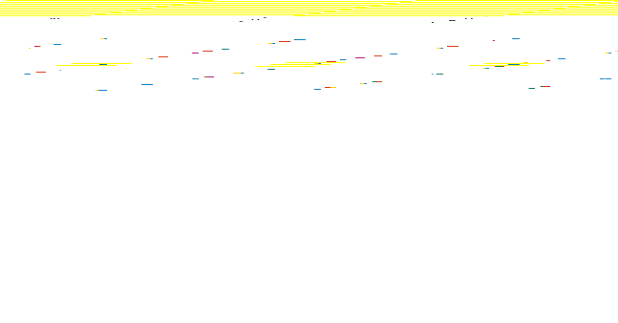
Example: how to learn a kernel: result

Slide 18
CNNs so far
The core computation required for a convolutional layer is a cross-correlation operation.
We saw that a simple nested for-loop is all that is required to compute its value.
If we have multiple input and output channels, we perform a matrix-matrix operation between channels.

Slide 19
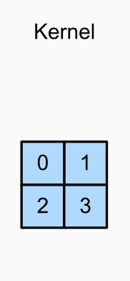
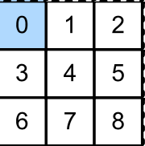
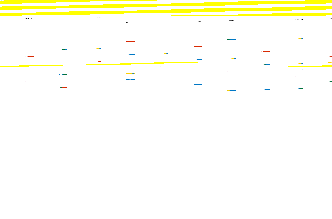
Padding and Stride
A tricky issue when applying convolutional layers is that we tend to lose pixels on the perimeter of our image.
Source: Dive into Deep Learning, Aston Zhang et al., https://d2l.ai

Slide 20
Padding
Since we typically use small kernels for any given convolution, we might only lose a few pixels, but this can add up as we apply many successive convolutional layers.
One straightforward solution to this problem is to add extra pixels of filler around the boundary of our input image, thus increasing the effective size of the image.
Typically, we set the values of the extra pixels to zero.
Source: Dive into Deep Learning, Aston Zhang et al., https://d2l.ai

Slide 21
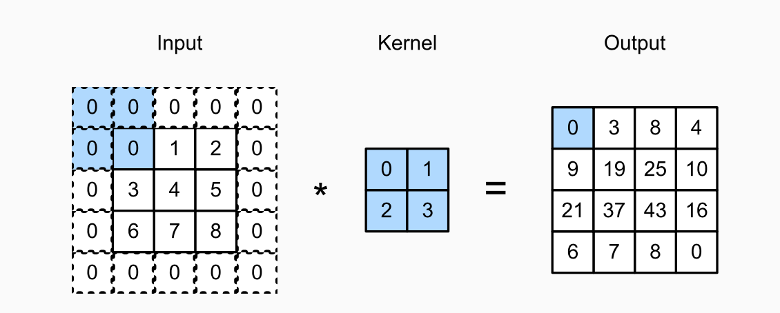
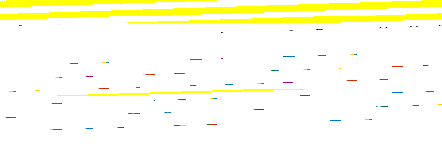
Padding: example
Source: Dive into Deep Learning, Aston Zhang et al., https://d2l.ai

Slide 22
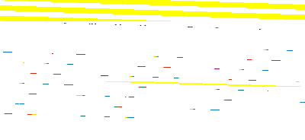
Choice of padding size
CNNs commonly use convolution kernels with odd height and width values, such as 1, 3, 5, or 7.
Choosing odd kernel sizes has the benefit that we can preserve the dimensionality while padding with the same number of rows on top and bottom and the same number of columns on left and right.
For any two-dimensional tensor X, when the kernel’s size is odd and the number of padding rows and columns on all sides are the same, an output with the same height and width as the input is produced.
Source: Dive into Deep Learning, Aston Zhang et al., https://d2l.ai

Slide 23
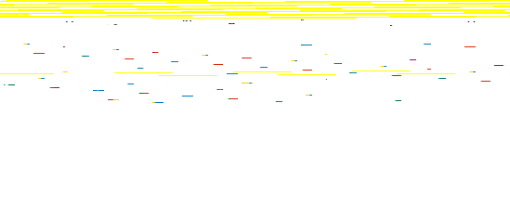
Stride
When computing the cross-correlation, we start with the convolution window at the upper-left corner of the input tensor and then slide it over all locations both down and to the right.
We have been sliding one element at a time in the previous examples.
Source: Dive into Deep Learning, Aston Zhang et al., https://d2l.ai

Slide 24
Stride
Sometimes, either for computational efficiency or because we wish to down sample, we move our window more than one element at a time, skipping the intermediate locations.
This is particularly useful if the convolution kernel is large since it captures a large area of the underlying image.
We refer to the number of rows and columns traversed per slide as stride.
Source: Dive into Deep Learning, Aston Zhang et al., https://d2l.ai

Slide 25
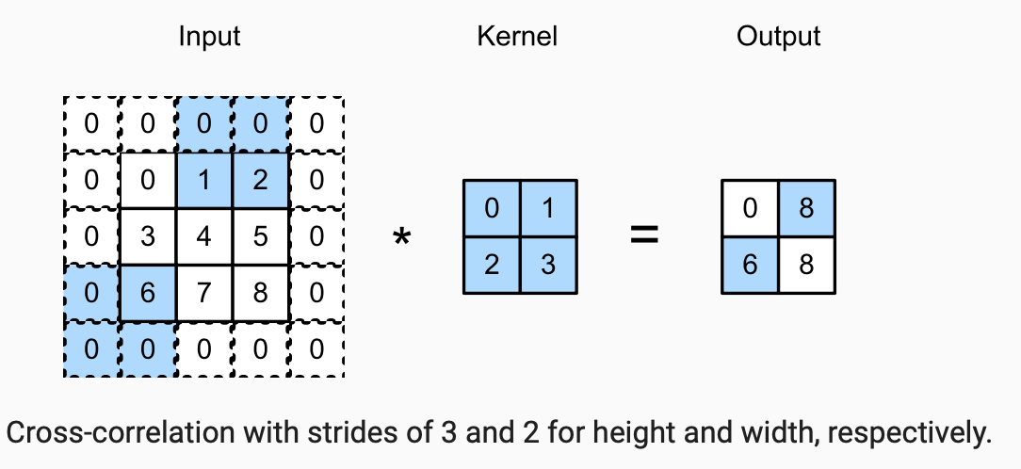

Stride: example
Source: Dive into Deep Learning, Aston Zhang et al., https://d2l.ai

Slide 26

Choice of padding
Padding can increase the height and width of the output.
This is often used to give the output the same height and width as the input to avoid undesirable shrinkage of the output.
Moreover, it ensures that all pixels are used equally frequently.
Typically, we pick symmetric padding on both sides of the input height and width.
Source: Dive into Deep Learning, Aston Zhang et al., https://d2l.ai

Slide 27
Multiple Input and Multiple Output Channels
Multiple channels can comprise each image (e.g., colour images have the standard RGB channels to indicate the amount of red, green and blue) , and we can have convolutional layers for multiple channels.
When the input data contains multiple channels, we need to construct a convolution kernel with the same number of input channels as the input data so that it can perform cross-correlation with the input data.
Source: Dive into Deep Learning, Aston Zhang et al., https://d2l.ai

Slide 28
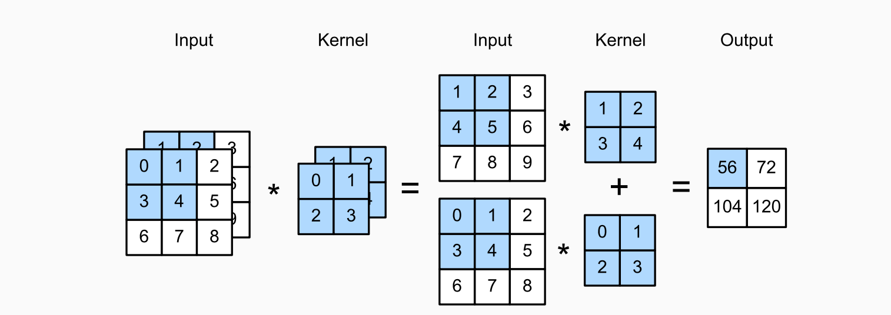
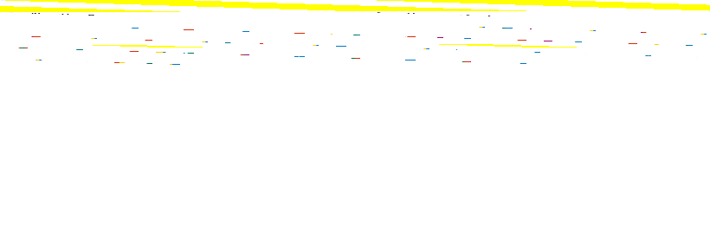
Multiple Input Channels: example
Source: Dive into Deep Learning, Aston Zhang et al., https://d2l.ai

Slide 29
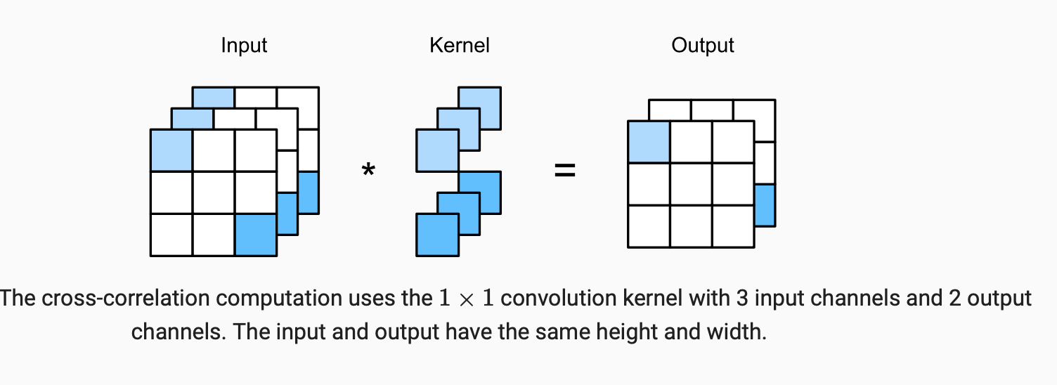

Multiple Output Channel: example (1x1 convolution)
Source: Dive into Deep Learning, Aston Zhang et al., https://d2l.ai

Slide 30
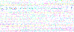
CNN Layers
Channels allow us to combine the best of both worlds: MLPs, which allow for significant nonlinearities, and convolutions, which allow for localised analysis of features.
Different layers convolution layers and changing the resolution (via pooling layers) allow the CNN to reason with multiple features, such as edge and shape detectors.
CNN models also offer a practical trade-off between the drastic parameter reduction arising from translation invariance and locality and the need for expressive and diverse models in computer vision.

Slide 31

Pooling
In many cases our ultimate task asks some global question about the image, e.g., does it contain a lesion?
Consequently, the units of our final layer should be sensitive to the entire input.
By gradually aggregating information, yielding coarser and coarser maps, we accomplish this goal of ultimately learning a global representation, while keeping all the advantages of convolutional layers at the intermediate layers of processing.
Source: Dive into Deep Learning, Aston Zhang et al., https://d2l.ai

Slide 32
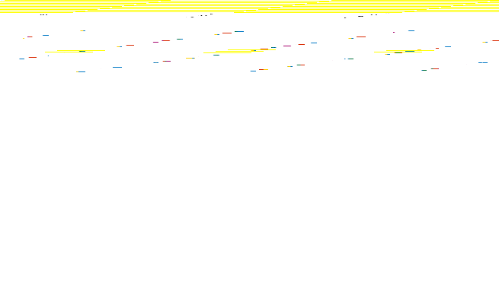
CNN – deep layers
image source: http://cs231n.stanford.edu/

Slide 33
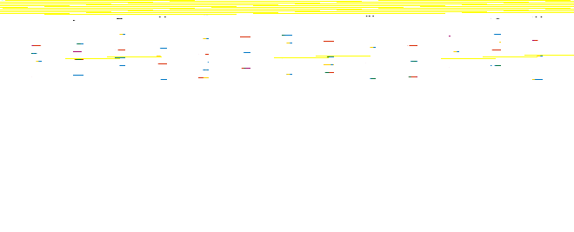
Deeper layers in CNNs
The deeper we go in the network, the larger the receptive field (relative to the input) to which each hidden node is sensitive.
Reducing spatial resolution accelerates this process since the convolution kernels cover a larger effective area.
In early layers, kernels learn simple patterns such as edges and corners.
In deeper layers of a multilayer CNN, kernels learn more abstract patterns, such as shapes, objects, or specific parts of objects.
Overall, convolution layers capture increasingly abstract features layer by layer.
Pooling layers help the model to be more robust to minor input variations.

Slide 34
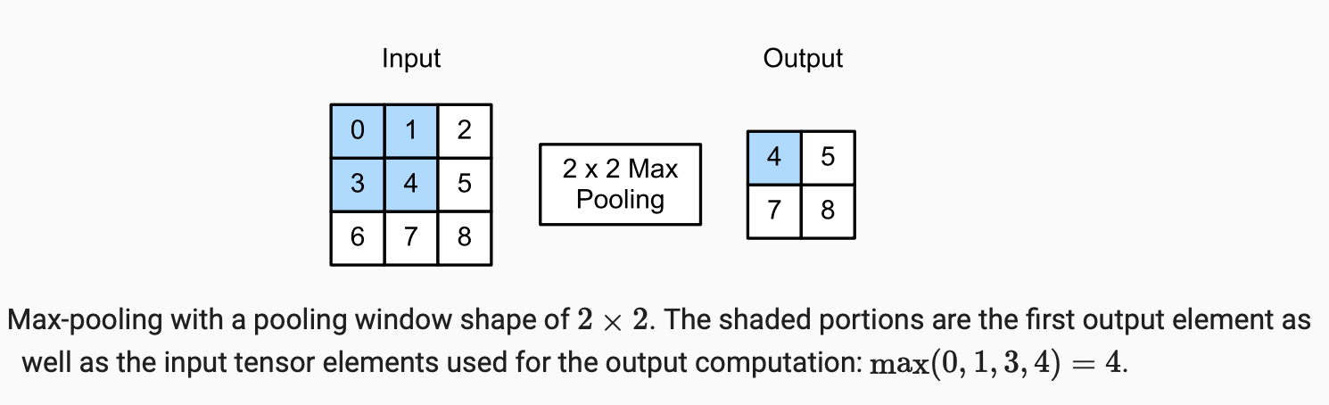
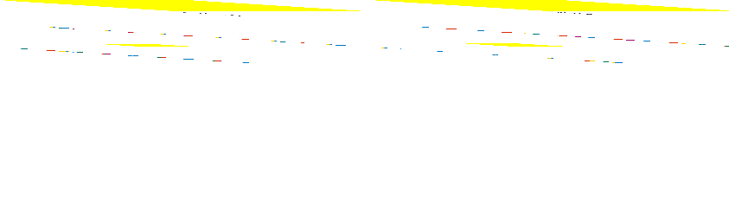
Maximum Pooling and Average Pooling
Source: Dive into Deep Learning, Aston Zhang et al., https://d2l.ai

Slide 35
Pooling
Like convolutional layers, pooling operators consist of a fixed-shape window that is slid over all regions in the input according to its stride, computing a single output for each location traversed by the fixed-shape window (sometimes known as the pooling window).
Source: Dive into Deep Learning, Aston Zhang et al., https://d2l.ai

Slide 36
Max-pooling and average-pooling
However, unlike the cross-correlation computation of the inputs and kernels in the convolutional layer, the pooling layer contains no parameters (there is no kernel).
Instead, pooling operators are deterministic, typically calculating either the maximum or the average value of the elements in the pooling window.
These operations are called maximum pooling (max-pooling for short) and average pooling, respectively.
Source: Dive into Deep Learning, Aston Zhang et al., https://d2l.ai

Slide 37
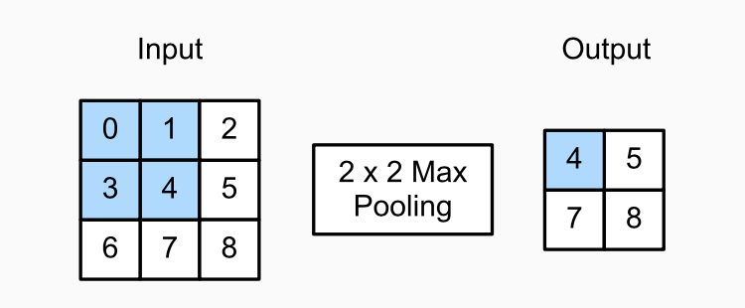
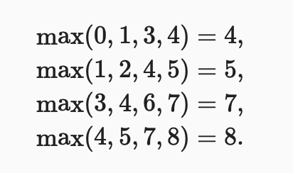
Max-pooling: revisiting the example
Source: Dive into Deep Learning, Aston Zhang et al., https://d2l.ai

Slide 38
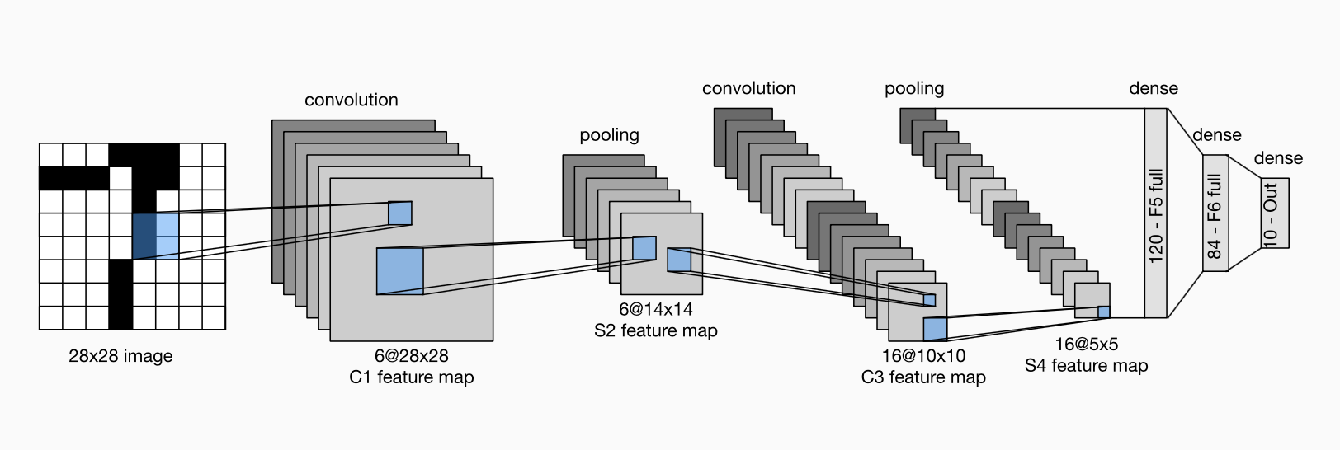

Convolutional Neural Networks: example LeNet

Slide 39


Compressed notion for LeNet-5

Slide 40



Example of a practical model: VGG-19
In practice, you use models such as VGG;
VGG: Very Deep Convolutional Networks for Large-Scale Image Recognition by Karen Simonyan, Andrew Zisserman, ICLR 2015, https://arxiv.org/pdf/1409.1556
Image source: Bansal, M., Kumar, M., Sachdeva, M. et al. Transfer learning for image classification using VGG19: Caltech-101 image data set. J Ambient Intell Human Comput 14, 3609–3620 (2023). https://doi.org/10.1007/s12652-021-03488-z

Slide 41

CNN Autoencoder
image source: https://towardsdatascience.com/convolutional-autoencoders-for-image-noise-reduction-32fce9fc1763

Slide 42






More examples
A sample filter which mainly focuses on the middle and top right areas out of data.
A sample filter which focuses almost on an L shape area (not equally) from the data.

Slide 43


CNN Example: VGG model for cell microscopy data analysis
( Nan Fletcher-Lloyd, 2025)

Slide 44
Revisiting the initial example
image source: http://cs231n.stanford.edu/

Slide 45
Review questions

Slide 46
Q1
In a CNN network, what technique has been used if a method generates results shown in section (b) from the data grid shown in section (a)?
12 | 10 | 3 | 2
8 | 6 | 1 | 0
4 | 7 | 5 | 7
4 | 6 | 6 | 8
12 | 3
7 | 8
(a)
(b)

Slide 47
Q2
In a CNN network, if we have the kernel shown in (a) and want to apply to the data shown (b) with a stride of 2, what padding size would you recommend?
1 | -1
-1 | 1
12 | 10 | 3 | 2
8 | 6 | 1 | 0
4 | 7 | 5 | 7
4 | 6 | 6 | 8
(a)
(b)

Slide 48
Q3
Which operation reduces the spatial dimensions of an image in CNNs? A) Convolution B) Pooling C) Padding D) Fully connected layer

Slide 49
Q4
What does "padding" in CNNs achieve? A) Reduces the computational cost of the network B) Prevents overfitting during training C) Maintains the spatial dimensions of the input D) Enhances gradient descent optimisation

Slide 50
Q5
What is the receptive field in CNNs? A) The total number of filters used in a layer B) The region of the input image that affects a single output value C) The activation map produced by a convolution D) The number of the kernel applied during convolution

Slide 51
If you have any questions
Please feel free to arrange a meeting or email (p.barnaghi@imperial.ac.uk) - my office: 928, Sir Michael Uren Research Hub, White City Campus.

